Slide 1
PROJECT DS_P460-Group 3
Classification- Resume Classification
This presentation provides a detailed overview of resume classification.The goal is to categorize resumes based on key attributes such as skills, experience, and education, enabling efficient and accurate candidate matching for specific job roles.

Slide 2
Mentors & Dedicated Team
Dedicated Team Members
Banavath Nagaraju
Varun BR
Sushanth Shetty
Gokila G
Balu Srividya
Mentors
Dilvar Basha
Abirami R

Slide 3
SUMMARY
Introduction
EDA
Model Building
Model Evaluation and Accuracy
Deployment
Problems Faced
Conclusion

Slide 4
PROJECT ARCHITECTURE
Architecture:
Collection of data
EDA
Model Building
DEPLOYEMENT
Model Evaluation

Slide 5
INTRODUCTION
Purpose: Resume classification automates the process of sorting resumes based on skills, experience,
and qualifications, ensuring efficient candidate filtering for specific job roles.
Significance: It saves time, reduces manual effort, and enhances accuracy in recruitment by Enabling
consistent and data-driven candidate evaluation.
Core Process: Extracts key information from resumes and categorizes them using algorithms, making it easier for recruiters to identify suitable matches.

Slide 6
EXPLORATORY DATA ANALYSIS
.
.
Exploratory Data Analysis (EDA) for a Resume Classification project involves understanding, visualizing, and preparing resume data for effective classification. Below is a detailed guide on how to perform EDA in such a project.
Classify resumes into pre defined categories.example based on role,industries and skills
Visualize the distribution of resumes across categories to check class imbalance.
Extract and explore patterns in skills,especially for category specific insights.

Slide 7
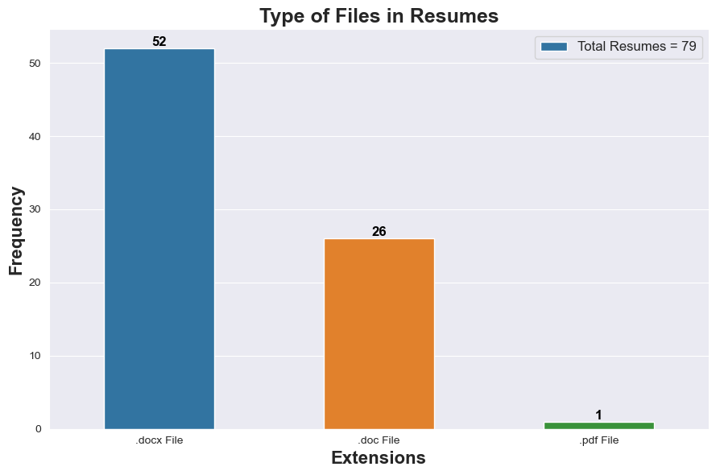
VISUALIZATIONS-EDA
This bar graph shows the frequency of fils in different formats, including DOCX, DOC, and PDF.

Slide 8
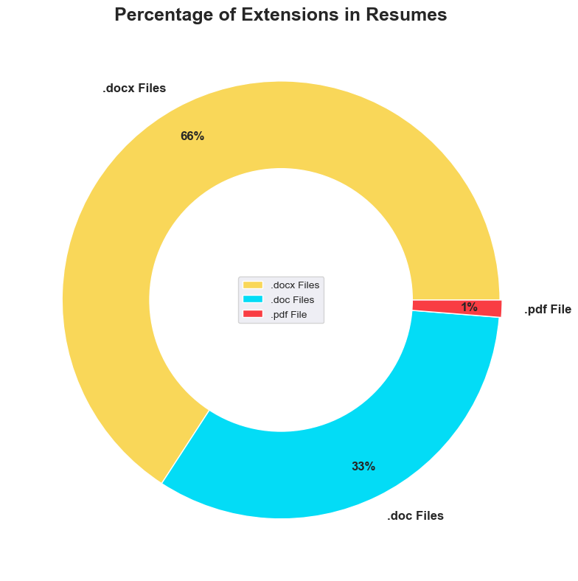
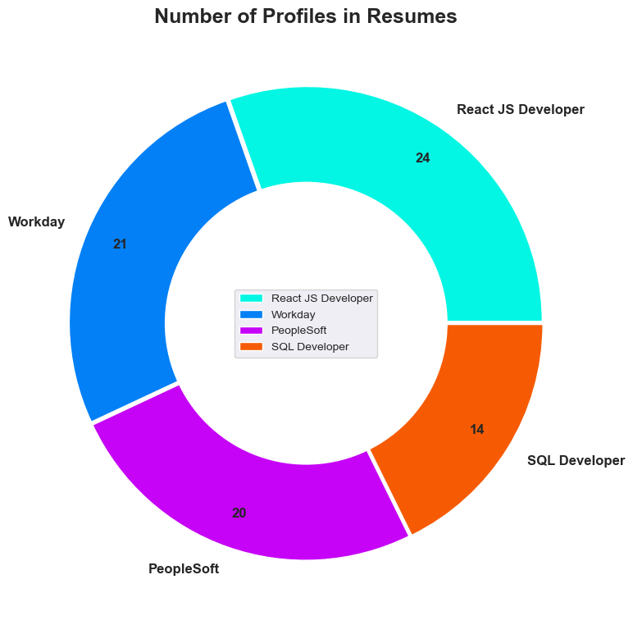
The first pie chart shows the percentage distribution of different file formats, while the second pie chart illustrates the percentage of profiles included in the resume dataset
Percentage Of Extensions in Resumes Number of profiles in resumes

Slide 9
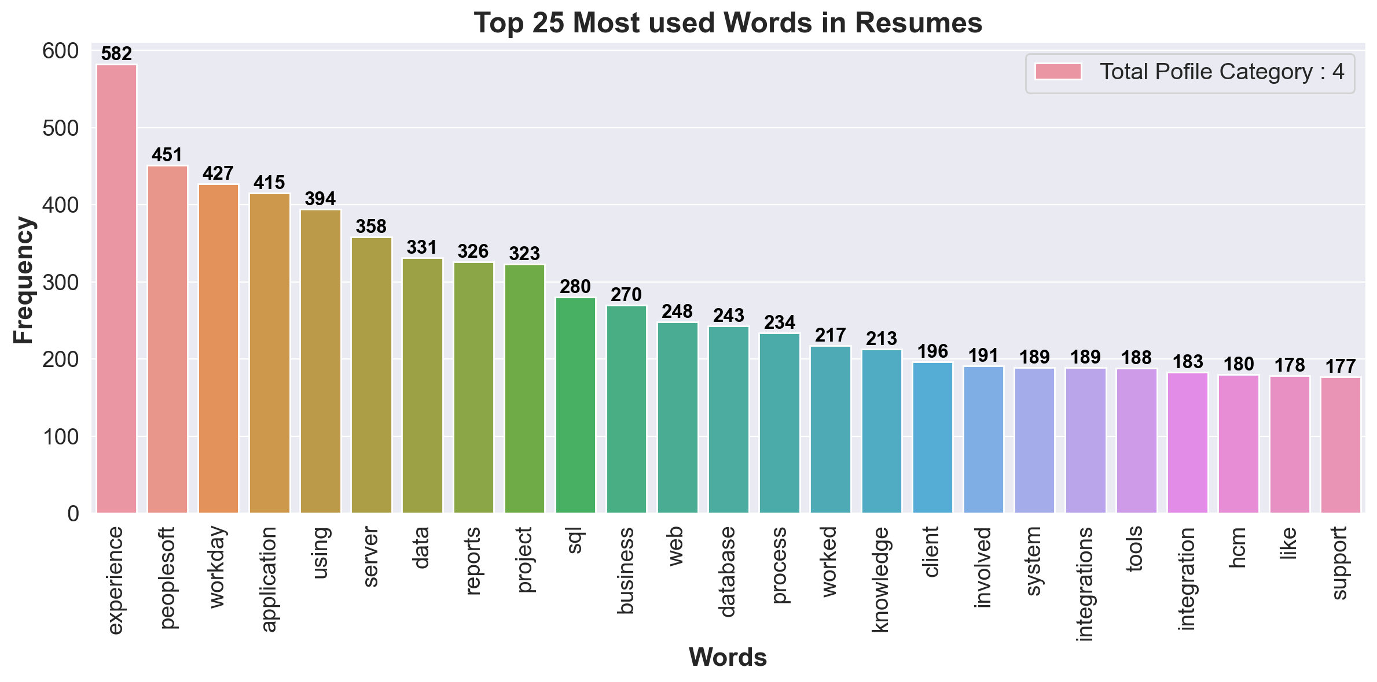
Most common words using in resumes
This graph shows that the most common words using in resumes after parsing of resume.

Slide 10
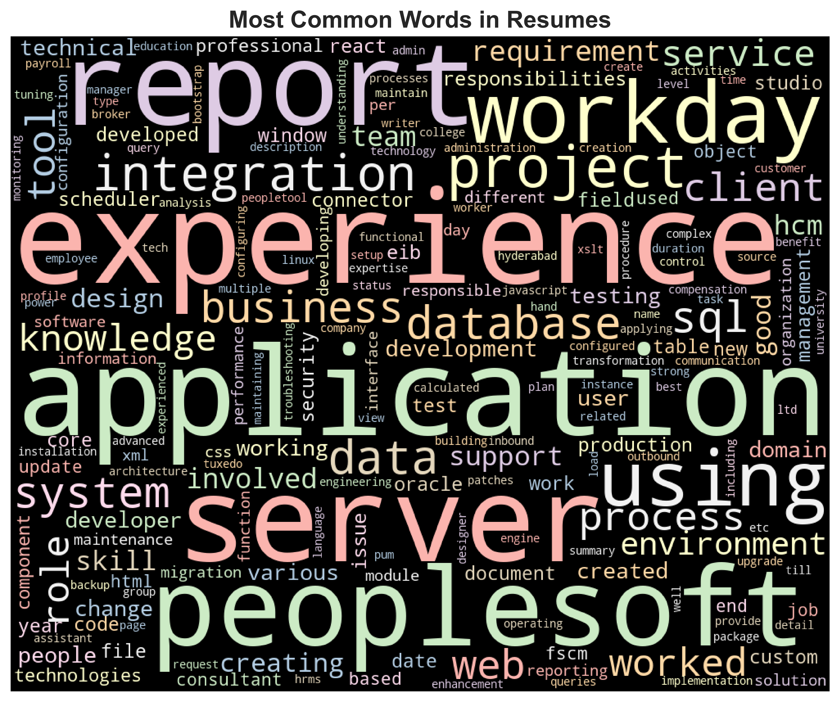
FREQUENT WORDS
Use counter or collections to identify the most common words.
word cloud to visualize high frequency words.

Slide 11
MODEL BUILDING
For model building, we employed various algorithms including Logistic regression,Random Forest, Decision Tree,Support Vector Machine (SVM), K-Nearest Neighbors (KNN), and Navie Bayesr’s classification.
The performance of each model was evaluated by comparing their testing accuracy scores to determine the most effective approach for resume clasification.

Slide 12
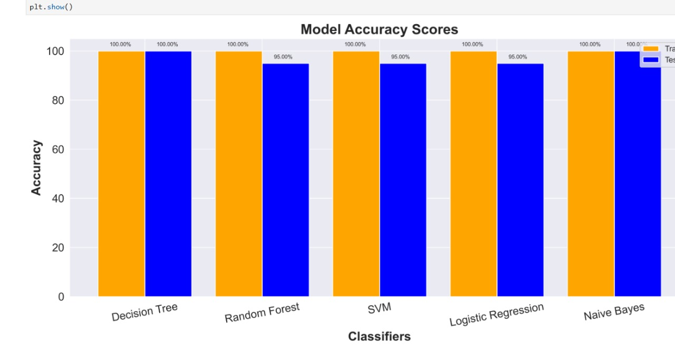
Model Building
Based on the Model Evaluation, we selected Decision tree as the Best fit for this project, as they achieved the highest test accuracy of 1.0.

Slide 13
MODEL EVALUATION
Logistic Regression: Decision Tree Classifire:
Accuracy Score: 1.0 Accuracy Score: 1.0
Training Accuracy: 1.0 Training Accuracy:1.0
Testing Accuracy: 1.0 Testing Accuracy:1.0
ROC score=92 ROC score=98
SVM Classifire:
Accuracy Score:1.0
Training Accuracy: 1.0
Testing Accuracy: 1.0
ROC score=97

Slide 14
Model evaluation
Ranom forest: Navie Bayer’s:
Accuracy Score:1.0 Accuracy Score:1.0
Testing Score:1.0 Testing Score:1.0
Training Score:1.0 Training Score:1.0
ROC score-97 ROC score-97

Slide 15
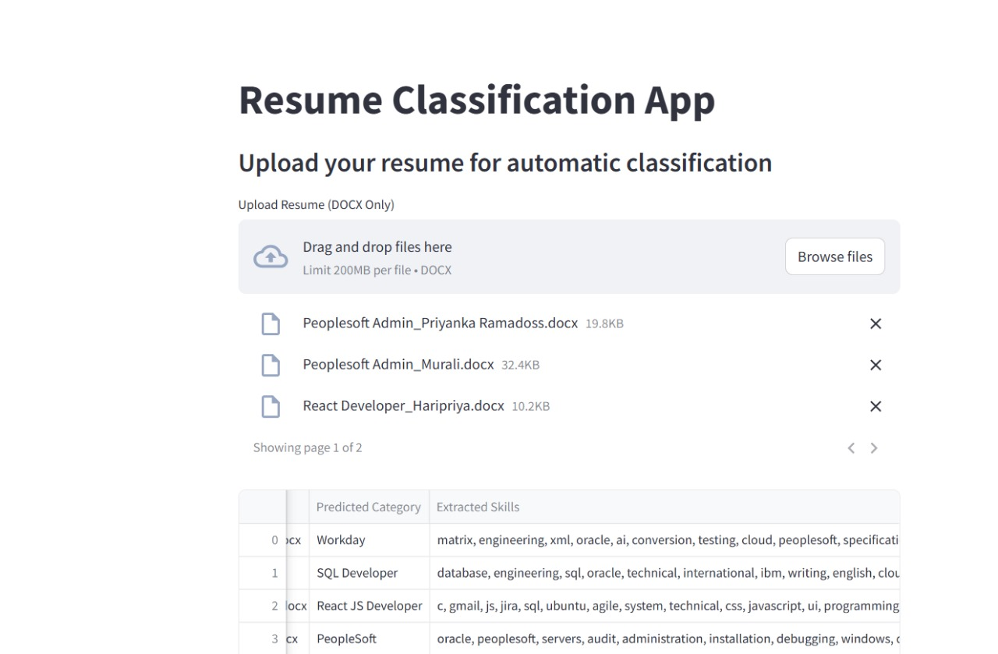
DEPLOYMENT

Slide 16
CHALLENGES
Variety in Resume Formats: Resumes come in various formats (PDF, DOCX, plain text, etc.),
making it difficult to consistently extract and process information.
Unstructured Data: Resumes often contain unstructured text, such as varied descriptions of skills
and experiences, which complicates information extraction and classification.
Varying Terminology: Candidates may use different terms or phrases to describe similar skills or
roles, making it challenging to standardize the classification process.
Bias in Classification: If the model is trained on biased data, it can lead to unfair or skewed
classifications, potentially favoring certain demographics over others.

Slide 17
CONCLUSION
Loaded and cleaned the dataset in Jupyter Notebook.
Performed exploratory data analysis (EDA) to understand data patterns.
Tested multiple models, selecting Decision Tree for its high accuracy and ROC score.
Deployed the model using Streamlit for real-time resume classification.
The deployed model reliably categorizes resumes into relevant job roles or skill categories.
Provides recruiters with an efficient and automated solution, reducing manual effort and saving time..
The system enhances the recruitment process by improving the accuracy of candidate-role matching.

Slide 18


